Slide 1
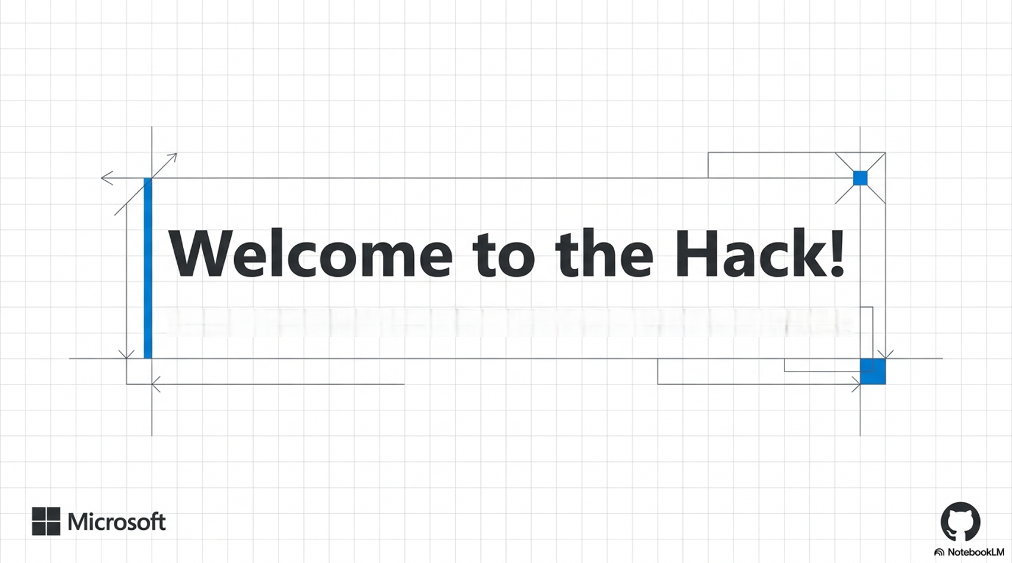

Slide 2
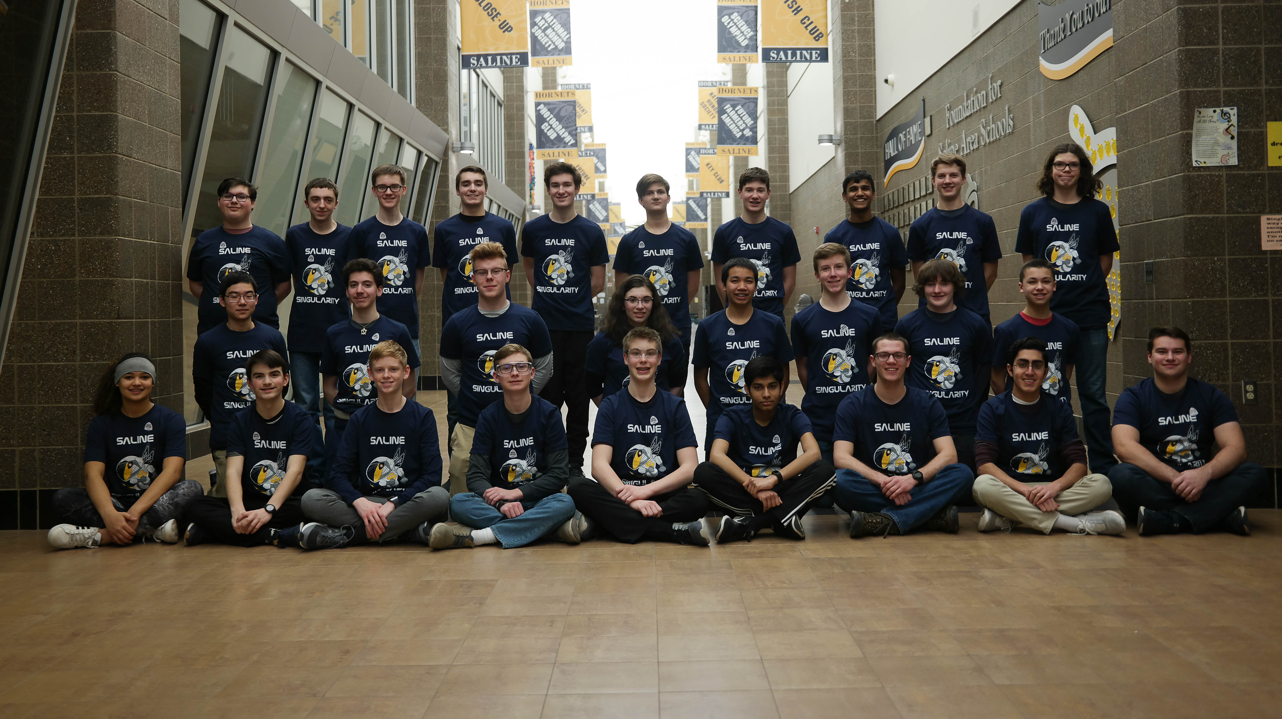
Saline Singularity - 5066
Notes:
Brief personal story. Connect FIRST Robotics coaching background to why building Misty's brain matters to you personally. Keep it short and warm.

Slide 3
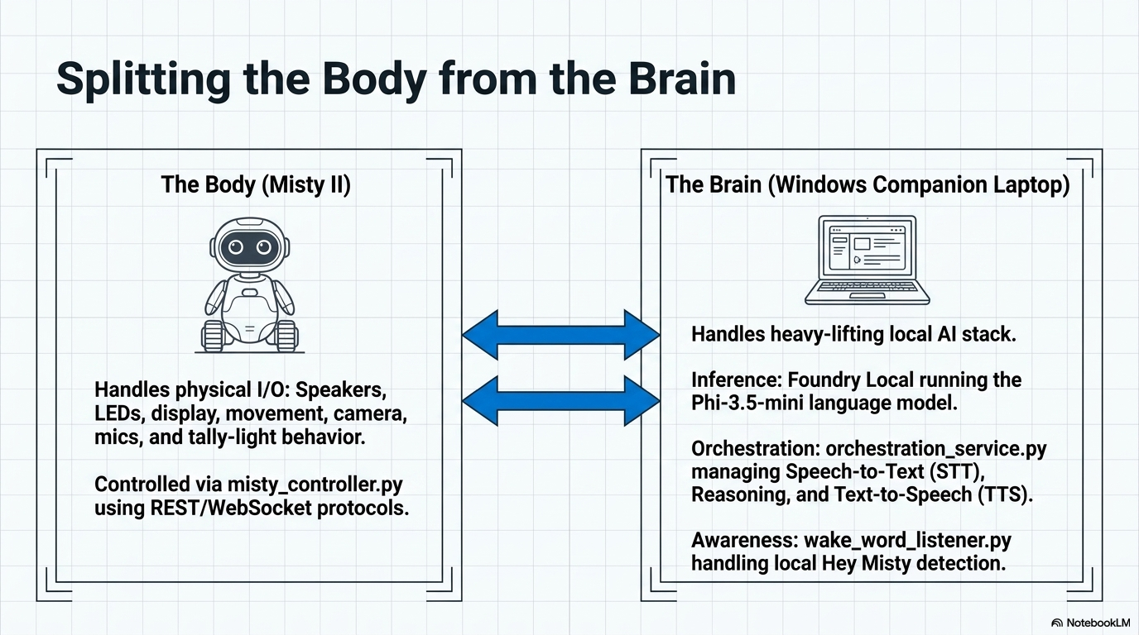
Notes:
Explain the split: Misty II is the body, the companion laptop is the brain. Walk through the two columns. Emphasize Misty cannot run modern inference herself; the laptop does that locally via Foundry Local + Phi-3.5-mini.

Slide 4
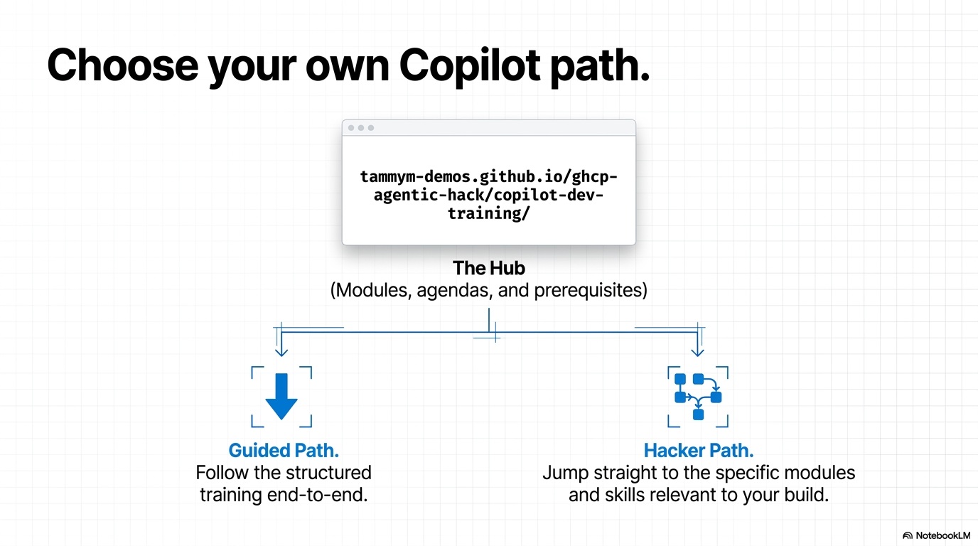
Notes:
Pull up the training hub site live if possible. Explain it's the participant home base for modules, agenda, prerequisites, and skills — pick your own journey, guided path or jump straight to what's relevant.

Slide 5
Hack Value Statement
Problem
What problems are we solving?
-
-
-
-
Scope
What is the scope of the project?
-
-
-
-
Impact
What is the measurable impact ($$$)?
-
-
-
-
Actions
Who owns the actions going forward?
-
-
-
-

Slide 6
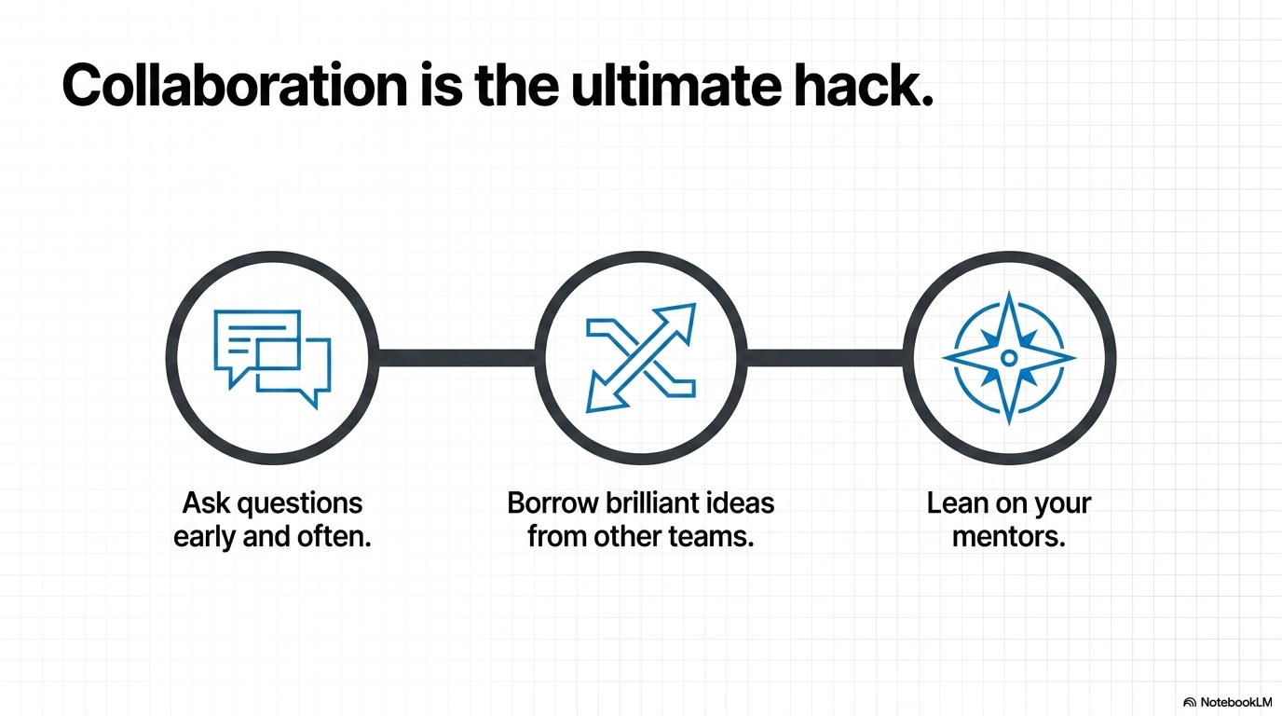

Slide 7
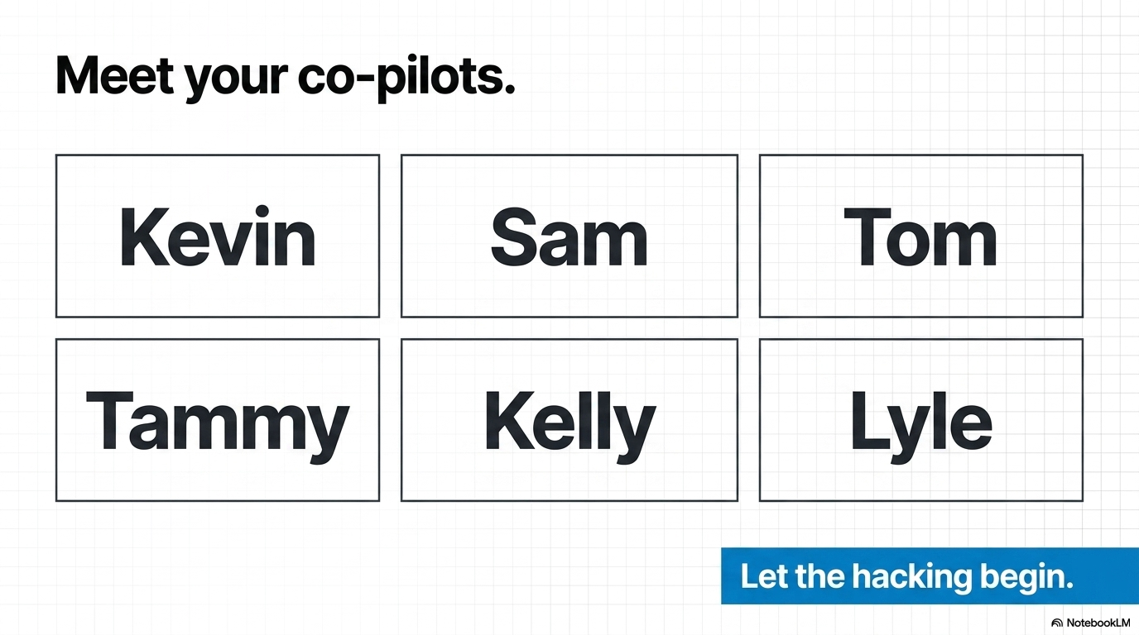
Notes:
Introduce Kevin, Sam, Tom, Tammy, Kelly, and Lyle by name. Close with energy: let the hacking begin.

